Slide 1
Module 10 – Modules and Packages
10: Regular Expressions
11: Object Oriented Programming (OOP)
12: Error Handling and Exceptions

Slide 2
By the end of this chapter, learners will be able to:
Understand what modules and packages are
Know why it's good to use multiple source files
Import modules and names
Utilise directories and namespaces as packages
Implement code that utilises the 'main' trick
Create module documentation by using docstrings
Use the Python profiler to understand how code behaves
Notes:
We have already met modules that are bundled with Python, now we shall discuss writing our own

Slide 3
What are modules?
A module is a file containing code.
Usually, but not exclusively, written in Python.
Usually with a .py filename suffix (some modules are built-in).
A module might be byte-code (and have a .pyc extension)
Python will create a .pyc file if none exists.
Held in subdirectory __pycache__ from Python 3.2.
Python will overwrite this if the .py file is younger.
A module might be a DLL or shared object.
With a .pyd filename suffix.
Often written in C as a Python extension.
‘Modules should have short, all-lowercase names.’
PEP008
Notes:
The modules we have seen so far have been bundled with Python, and we have used them as just another part of the language. The built-ins are not physically separate modules, although we have a logical view of them as being just like any other. Those aside, all modules are represented by separate files, which are logically independent from the main program.
Rather than compile a module each time it is loaded, Python compiles once and dumps the byte-code into another file. From Python 3.2, these files are held in a sub-directory called __pycache__.
Byte-code files (.pyc) are not necessarily portable, either across platforms or between releases. The files themselves contain a "magic number" which indicates the Python release they were built for, and incompatible byte-code files will be recreated. It is therefore important that a bundled package includes the source code (.py files) as well as the byte-code files if required. This has led to issues where multiple versions of Python are regularly used, in that Python would be continually recompiling. From Python 3.2, the version of Python is also included in the filename in __pycache__, for example: abc.cpython-32.pyc.
Modules written as C extensions are generally created as a DLL (on Windows) or shared object (Linux/UNIX .so files). These have the file extension .pyd but are otherwise identical to a native binary.

Slide 4
Multiple source files – why bother?
Increase maintainability
Independent modules can be understood easily.
Functional decomposition
Simplify the implementation.
Encapsulation & information hiding
Easier re-use of modules in a different program.
Easier to change module without affecting the entire program.
Support concurrent development
Multiple people working simultaneously.
Debug separately in discrete units.
Promote reuse
Logical variable and function names can safely be reused.
Use or adapt available standard modules .
Notes:
A Python module is somewhat like a separate source file or DLL in C or C++.
However, it is more than that:
Variables can be local to the module
Packages have an independent namespace
For OO-programming, each module can implement a single class
The term package is used to indicate a collection of modules, on a local disk or stored on the network. Specifically in Python, it is the directory that the modules reside in.
The reasons for splitting-up an application into modules are all based on good structured programming techniques, however, the overriding reason is code reuse - why reinvent when someone else has already written the code.

Slide 5
How does Python find a module?
The initial path is from sys.path
May be modified using sys.path.append(dirname).
Starts with the directory from which the main program was loaded.
Or change environment variable PYTHONPATH
Contains a list of directories to be searched.
Separator is the same as your system's PATH.
: for *NIX ; for Windows.
import sys
sys.path.append('./demomodules')
import mymodule
print(sys.path)
['C:\\QA\\Python\\MyDemos', 'C:\\Python30\\Lib', ...
./demomodules]
Notes:
The directories searched for Python modules will vary depending on the platform and installation but always includes the current directory. Windows also has C:\Python3n\Lib\site-packages. To find the path used just print sys.path.
To add a directory to the path, either use sys.path.append, or the environment variable PYTHONPATH.
Note that either directory separator (/ or \\) may be used on Windows.

Slide 6
Importing a module
Surprisingly, use the import command
At the top of your program, by convention:
Can specify a comma-separated list of module names:
Can specify an alias for a module name:
Trouble is, you have to specify the module name for each call.
import mymodule
print(mymodule.attribute)
Case sensitive, even on Windows
import mymodule_a, mymodule_b, mymodule_c
import mymodule_win32 as mymodule
print(mymodule.attribute)
Notes:
We have seen the basics of importing modules already - after all, you can't do much in a Python program without using import. Here are a few more details.
Notice that the case of the module name must match that of the file name. By default, this also applies to Microsoft Windows, unless the environment variable PYTHONCASEOK is set. We can specify an alias if required, and that is a commonly used feature.
Modules already loaded can be reloaded using (surprise) imp.reload. This may be useful if you are creating the modules programmatically.

Slide 7
Importing names
Alternatively, import the names into your namespace.
Beware! Risk of name collisions!
Specify specific object name(s):
Or use an alias:
from mymodule import *
from mymodule import my_func1
...
my_func1()
How do we know which module my_func1 came from?
from mymodule import \
(my_func1 as mf1, my_func2 as mf2)
mf1()
mf2()
Better or worse?
Notes:
Specifying the name of the module for each function call can be tedious, so we can import all the external names on the module into our own namespace. The problem is that this can lead to "Namespace pollution", so instead, we can specify exactly which names to import.
If those names clash with existing names within the program (name collisions), then we can assign aliases to individual names. However, it can then get very difficult to track back which names belong to which module, so choose your aliases carefully!
Note that we can only import public names, that is those not prefixed with an underscore, or those specified in __all__.

Slide 8
Writing a module
No special header or footer required in the file.
Just write your code without a 'main’.
Default documentation is generated and available through help().
Conventions with underscores – reminder.
Names beginning with one underscore are private to a module.
Includes function names.
Names beginning and ending with two underscores have a special meaning.
Name of the module is available in __name__.
def my_func1():
print("Hello from", __name__)
Notes:
A module in Python required no special header or delimiter in the file - any Python code file can be a module. The module can be without a "main", or a #! line and execute access (on UNIX), but see later when we discuss testing.
A single underscore prefix means that the name is not exported from a module, unless __all__ is specified in the package __init__.py file, in which case only those names will be exported. Names with two leading underscores are mangled, and so localised.

Slide 9
What are packages?
A package is a group of related modules organised into a directory structure.
Use to organise code hierarchically and avoid naming conflicts
Can contain sub-packages
Two kinds of package:
Regular
Contains a file called __init__.py and other py files
Namespace
Contains py files
Notes:
In Python, a module is the file itself, and a package is a group of modules in a directory (or folder, if you prefer). The directory itself is the package which may or may not contain a file called __init__.py .
If the directory does contain a __init__.py file it is known as a Regular package. The file is often empty or may just have a comment in it. It can also have a huge amount of code in it, depending on the whim of the author. One of the more useful attributes which can optionally be set is __all__, which gives a list of the public elements of the package.
From Python 3.3, Namespace packages were introduced. These don't have __init__.py file.

Slide 10
Regular Packages
When a directory contains an __init__.py file, Python treats it as a regular package. The __init__.py file:
Can be empty or contain initialization code
Runs when the package is first imported
Can define what gets imported when someone does from package import *
Can contain package-level variables, functions, or classes
Makes the package's structure explicit
mypackage/
__init__.py
module1.py
module2.py
subpackage/
__init__.py
submodule.py
# mypackage/__init__.py
from .module1 import important_function
from .module2 import MyClass
__version__ = "1.0.0"
__all__ = ['important_function', 'MyClass

Slide 11
Namespace Packages
Since Python 3.3, directories without __init__.py are treated as namespace packages. They:
Allow multiple directories with the same package name to be combined
Don't run any initialization code
Are useful for distributing parts of a package separately
Enable more flexible package structures across different locations
sys.path.append('./date_packages')
sys.path.append('./person_packages')
from mynames.date import Date
from mynames.person import Person
Where both directories have a sub-directory named mynames

Slide 12
Regular vs Namespace Packages
Use Regular Packages (with __init__.py) when:
You want initialization code to run when the package is imported
You need to control what gets imported with from package import *
You want to provide a clean API by importing key components at the package level
You're creating a traditional, self-contained package
You want to maintain compatibility with older Python versions
You need package-level constants or configuration
Use Namespace Packages (without __init__.py) when:
You're creating a plugin system where different parts can be installed separately
Multiple organizations contribute to the same logical package
You want to split a large package across multiple distributions
You don't need any package-level initialization
You want the simplest possible package structure
Notes:
If all you want a package for is to logically group modules together, then the traditional package mechanism (Regular packages) is rather inflexible. The initialisation performed by __init__.py can be very powerful, but it is not always appropriate.
Namespace packages allow a subdirectory to be the namespace, but that same subdirectory name can occur in any number of other parent directories. It is the subdirectory name that is used for the Namespace. See PEP0420 for further details.

Slide 13
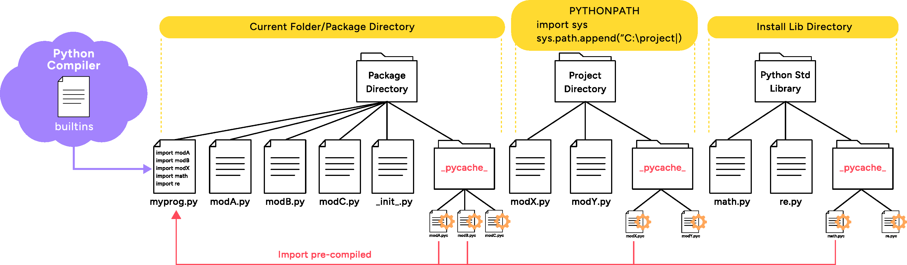
Finding Modules
Notes:
Python automatically stores compiled python modules in a __pycache__ folder, which is found in the Package directory or Python install directory. When you are importing a module, including Python Standard Library modules, it is the pre-compiled modules with a suffix .pyc which are loaded, reducing the time to compile. If the .py module file has a newer timestamp, then it is re-compiled
The Python interpreter finds the modules – as a built-in, in the current or package directory, in a list of directories defined in the PYTHONPATH environment variable, or an installation-dependent list of directories configured during Python install.
On Linux: $ export PYTHONPATH="${PYTHONPATH}:${HOME}/python/lib:/projectX/lib"
On Windows: [Right Click]Computer > Properties >Advanced System Settings > Environment Variables >System Variables >New
Within a program:
>>> import sys
>>> sys.path.append(r"C:\labs\projects\Proj_X")
>>> print(sys.path)
Importing a package, and then a sub-package (from the current package):
>>> import my_package
>>> from . import my_sub_package

Slide 14
The Namespace' trick
When we use the dunder __name__ in the file that’s being run, it will return the name main.
If we drop the print name into a function and import that into another file, the __name__ dunder will return the name of the file it was imported from. NOT the name main.
If __name__ == "__main__" checks to see if the Python file is being run as a script and not an import.
print(__name__)
__main__
form mainTest import importThis
importThis()
mainTest
Notes:
A script is what we call a python file that is run from a command line. The 3 main methods of running python are from the command line, as a file in an IDE or as the functionality being imported and run in another file.
Have you noticed the __name__ == "__main__" test we have been using in conjunction with a main() function? It's called the namespace trick and allows your script to act as a module and your module to act as a script. In other words, it allows the user to execute the module directly as a script and also import the module into another script without executing the main() function!
It's also part of structuring our Python scripts correctly. Continue using it! Oh, and always end your script with an error code – 0 indicates zero errors and any other integer (1-255) indicates an error code! This exit code is passed back to the calling program and indicates success or failure of your script.

Slide 15
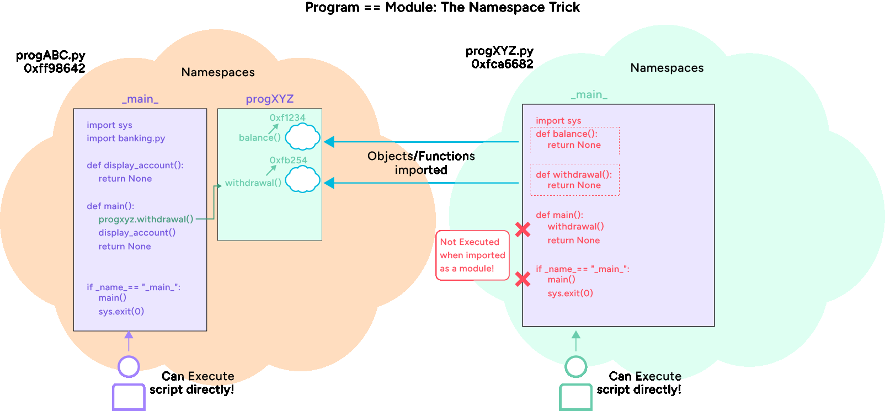
The 'Namespace' trick
Code outside of a function is executed at import time.
This is undesirable if our module could be independently run as a program in its own right.
Fortunately, we can test the name of a running module which will be __main__ if run as a program.
Notes:
It is not uncommon to develop a Python script and then realise that the majority of it would be useful as a module. Of course, that requires that we have written it by breaking down the functionality into callable functions, which good programmers will do naturally anyway. In a full program, there is always the need for a 'main', which might do nothing more than call functions in the correct order, but that would get run at import time if we tried to run our program as a module.
We could just remove the 'main' code, but that would make life more difficult if we wanted to have the choice of running it as a module or a program. So, we can use trickery by testing the module name. We don't know what you will choose as your module name, but it won't/can't be __main__. That is the name used for the main module when running a program. So, we can test the module attribute __name__ and choose which code to execute.
It is common practice to use a function called main, since that gives us the opportunity to have scoped variables (remember that in Python a conditional statement is not a unit of scope).
Some advocate always writing Python code in this way, including stand-alone programs, for maximum flexibility.

Slide 16
Module documentation
Docstring for the module must be at the (very) start:
Or explicitly assigned to __doc__
Used by the pydoc utility to generate documentation files.
A default help format is provided.
>>> help(mymodule_a)
Help on module mymodule_a:
NAME
mymodule_a
FILE
c:\qa\python\mydemos\demomodules\mymodule_a.py
DESCRIPTION
This is a test module containing one
function, my_func1
FUNCTIONS
my_func1()
my_func1 has no parameters and prints 'Hello'
DATA
var1 = 42
Module docstring
Function docstring
Notes:
Like functions, modules can contain docstrings, and these will be used as the documentation when help() is called. The format of the docstring is the same as for functions, and must occur at the very start of the module, even before any imports. If not at the start of the module, it can be assigned to the variable __doc__, for example:
__doc__ = """
This is a sample module which
does various date operations.
"""
Documentation in forms other than help() can be generated, using the lib/pydoc.py program (bundled with python). Documentation in HTML and UNIX man page format can be created, as well as searched using a small browser.
This is very useful on its own, but docstrings have other hidden magic…

Slide 17
Python profiler
The cProfile module
Profile a specific function from a script.
Or the whole script from the command-line.
Analyse the output file using pstats shell.
import mymodule
import cProfile
cProfile.run('mymodule.start()', 'start.prof')
Save statistics to this file (optional)
Default: display statistics to stdout
C:\QA>python -m cProfile thing.py
C:\QA>python -m pstats start.prof
Welcome to the profile statistics browser.
% help
Notes:
A profiler is useful to understand the way your code behaves. With simple scripts, it will not tell you much, it is really useful with large and complex applications and modules. The module cProfile is bundled with the standard Python release.
There is also a pure Python profiler called profile, but it is slower than cProfile and has the same functionality. In its simplest form, the output generated will tell you how many calls each of your functions and methods received, and how long was spent executing each function. The functions are identified by their line number and file name.
The module, and the analysis of the data, can be used in several ways. By using cProfile from a program it is possible to profile specific parts of the code - particularly useful when unit testing. The default output goes to stdout, but can be saved in a binary format for later analysis by pstats.
The pstats module can also be run in a number of ways. It can be run as a shell, as in the example, or programmatically. The program interface is best suited for analysing multiple statistics files in a complex environment and is documented in the Python documentation.
See also the trace module in the Python standard library.

Slide 18
Review & Lab
Answer review questions
Your instructor will guide you which lab exercises to complete

Slide 19
Review Questions
Suppose a function called add() is defined in a module called arithmetic.py. Which of the following code snippets correctly shows how to import and use the add() function? Select all that apply.
a.
import arithmetic
result = arithmetic.add(2, 3)
b.
from arithmetic import add
result = add(2, 3)
c.
from arithmetic import add
result = arithmetic.add(2, 3)
d.
import add from arithmetic
result = add(2, 3)
Notes:
Answers on final review questions page..

Slide 20
Review Questions
2. What is the difference between a module and a package in Python?.
A module is a folder, while a package is a single file
A module is a single .py file, while a package is a collection of modules inside a folder with an __init__.py file
Both terms mean the same
A package can only contain built-in functions, while modules cannot
Notes:
Answers on next page

Slide 21
Review Questions
3. Where does Python look for modules when using import?
Only in the current working directory
In the PYTHONPATH, current directory, and standard library locations
Only in the site-packages directory
Nowhere, you must specify the absolute path
4. What is the purpose of the if __name__ == "__main__": statement in Python?
It defines the main function of every Python program
It specifies the entry point for Python packages on PyPI
It ensures that a block of code only runs when the file is executed directly, not when imported as a module
It prevents a module from being imported
Notes:
Correct answers:
Suppose a function called add() is defined in a module called arithmetic.py. Which of the following code snippets correctly shows how to import and use the add() function?
a and b
import arithmetic
result = arithmetic.add(2, 3)
from arithmetic import add
result = add(2, 3)
2. What is the difference between a module and a package in Python?
b. A module is a single .py file, while a package is a collection of modules inside a folder with an __init__.py file
This is the classic distinction.
__init__.py makes the folder behave like a package.
3. Where does Python look for modules when using import?
b. In the PYTHONPATH, current directory, and standard library locations.
Python searches these locations in order, which you can check with sys.path.
4. What is the purpose of the if __name__ == "__main__": statement in Python?
c. It ensures that a block of code only runs when the file is executed directly, not when imported as a module
Every Python file has a built-in variable called __name__.When a file is run directly (e.g., python script.py), Python sets __name__ = "__main__".When the file is imported as a module in another script, __name__ will instead be the module’s name (e.g., "script").

Slide 22
Summary
Writing a module in Python is simple.
Just a bunch of code in a file.
Python loads modules based on sys.path.
Import a module using import.
Can also specify importing names into our namespace.
Directories can be packages.
Require the __init__.py file.
There are several features and base modules to assist testing.

Slide 23
Distributing libraries – distutils
Enables programs, modules, and packages to be bundled and unbundled in a standard way.
Part of the standard library.
Based on setup.py written by the distributer (see over).
Creating a distribution.
Compressed file is placed into sub-directory ./dist
Installing a distribution:
C:\product> python setup.py sdist
C:\product\dist> unzip product-1.0.zip
C:\product\dist> cd product-1.0
C:\product\dist> python setup.py install
Notes:
The distutils module is designed to provide a uniform interface for users to create, distribute, and install modules and associated files. From the user's viewpoint, it is based around a script normally called setup.py, which is described on the next page. The distribution is usually in the form of a zip file or a gzip tarball, depending on the platform, created in a sub-directory called dist.
For pure python modules, the sdist argument for setup.py should be sufficient, sdist means source distribution. If the distribution includes binary files, such as executables or other platform specific files, then it should be bdist. A binary distribution will include the .pyc files for the modules.
The argument bdist_wininst will produce an .exe file which the user has to just double-click on to invoke the Windows installer. This also registers the module, so it can be uninstalled using the control panel. Beware that the generated .exe file can be architecture specific, so that a 64-bit .exe file will not run on a 32-bit Windows installation.

Slide 24
Distributing libraries – distutils
There is a standard way of organising your files:
Described in setup.py.
from distutils.core import setup
from glob import glob
setup(
name = "pydealer_pickcard",
version = "1.0",
author = "QA",
author_email = "QA.com",
py_modules = ['libcard'],
packages = ['showcard'],
scripts = ['simple.py'],
data_files = [
('Bitmaps',glob('Bitmaps/*')),
('.', ['qa.ico'])],
)
pydealer_pickcard/
README.txt
Documentation.txt
libcard.py
showcard/
__init__.py
showcard.py
simple.py
Bitmaps
QA.ico
Notes:
When generating a distribution, the first thing to do is to organise your files in the standard way. If you don't like the standard layout, then you can specify a different one in setup.py, but that is not worth the effort unless you have a very good reason. The top-level directory does not have to be the name of the distribution, but it would be confusing if it was not.
The next step is to write setup.py. The example shown does not include all possible combinations, but covers many that are optional. The absolute minimum setup.py for a single module is:
from distutils.core import setup
setup(
name = "modulename",
py_modules = ['modulename'],
)
The default version number is 0.0.0, so it is probably best to set a version number as well.

